Slide 1
Vehicle Monitoring System
Computing Project
-Rohit parajuli

Slide 2
Introduction
Vehicle monitoring with location tracking involves driver or vehicle tracking using Global Positioning System (GPS) which is a satellite-based navigation for marking the position of someone/something.
Also, this system provides reminders about vehicle insurance, tax, fuel and servicing date managing the information that users find difficult to remember.

Slide 3
Problem statement
Also, company cannot manage bulk of information manually as they have to manage numerous vehicles and monitoring is somewhat difficult in the scenario.
This system is solution to vehicle security, monitoring and condition.

Slide 4
Background of Project
People cannot always have time to manage information about their car and at some event of time they might have to face issues legally about tax payment just because they couldn’t get notified about tax payment which they forgot to record.
We might not always be able to access our paper log we keep at our home to update our information anywhere at any time.

Slide 5
Aims and Objectives
Aims
To provide an interface to the owner to track location of their vehicles and be addressed about any suspicious activity of the driver.
To provide an interface to enter, retrieve and edit information about their vehicle payments, other driver information, payment schedule, deadlines, fuel quantity and address owners accordingly.

Slide 6
Aims and Objectives
Objectives
Payment record to be automated which eliminates the paper-based log about vehicle information of payments.
Provide an interface for driver registration along with their API key.
Location tracking by using the entered API key during registration.
The interface of Google Map provided to admin(owners) to monitor their vehicles.
Provide an interface to enter deadlines for payments and address owners through registration.

Slide 7
Features of Project
Owners can track vehicle and driver location using GPS.
API key for location mark is entered during registration of vehicles and users.
The accurate location is determined using satellite navigation and internet access.
Users can enter payment date, deadlines, servicing date manually.
They can update payment information and date.
Company can register new drivers and keep hold of their vital information.
Company can edit hired driver information accordingly.

Slide 8
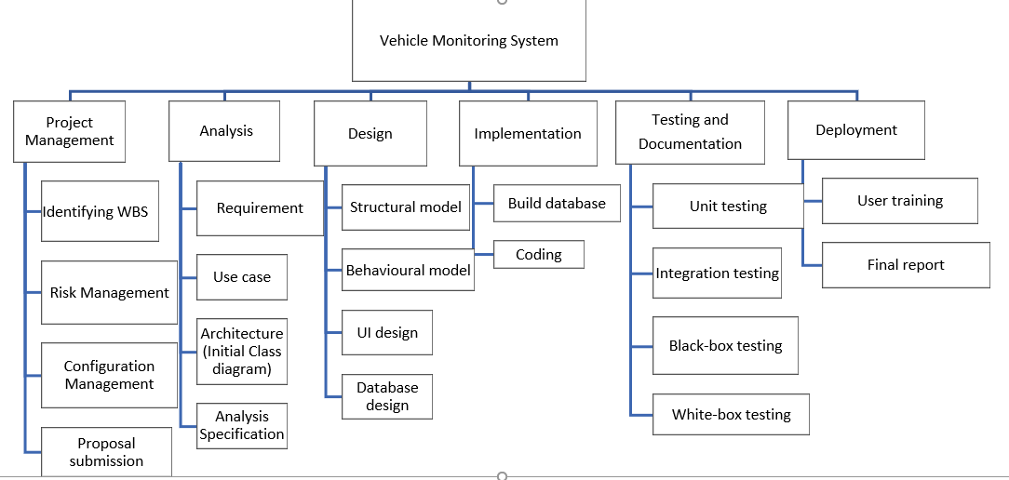
WBS

Slide 9
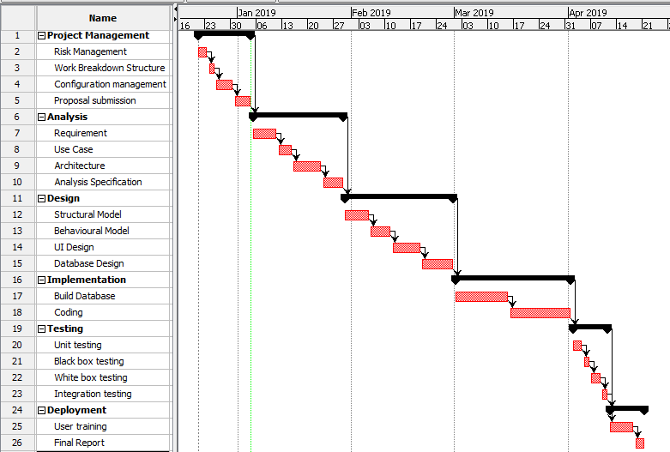
Gantt Chart

Slide 10
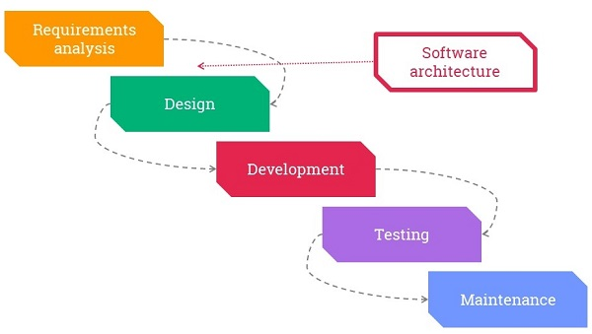
Methodology
Waterfall model
We approach the system development through Waterfall model which is a linear-sequential life cycle model which is divided into phases where each phase must be completed before the next phase can begin and there is no overlapping in the phases.

Slide 11
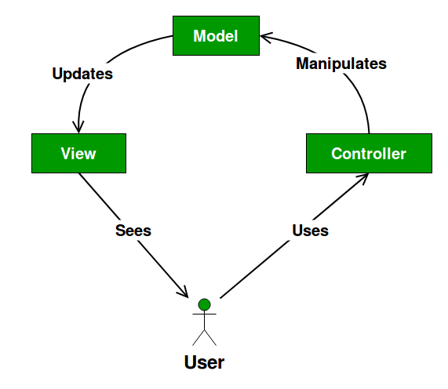
Architecture with diagram
MVC design pattern would be used for system design and development.
The Model View Controller (MVC) design pattern specifies that an application consist of a data model, presentation information, and control information.

Slide 12
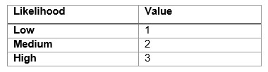
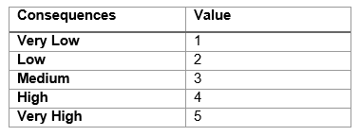
Risk and Configuration Management
Risk management
Managing risks on projects is a process that includes risk assessment and a mitigation strategy for those risks
Impact= Likelihood* Consequence

Slide 13
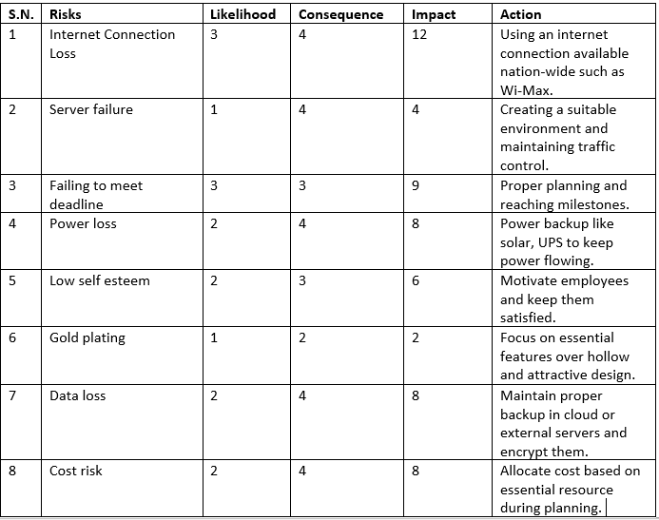
Risk and Configuration management -2

Slide 14
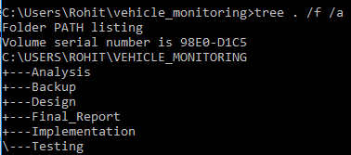
Risk and Configuration Management -3
Configuration management
Configuration management (CM) is a governance and systems engineering process for ensuring consistency among physical and logical assets in an operational environment.
The configuration management process seeks to identify and track individual configuration items (CIs), documenting functional capabilities and interdependencies.

Slide 15
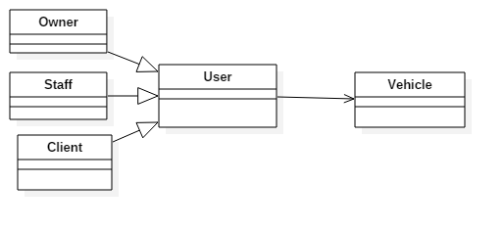
Design
Initial Class diagram

Slide 16
Design -2
Justification
It forces the programmer to think out the structure of his/her classes and how they will interact with each other before actually writing any code. This may lead to a more robust application.
It provides a blueprint for maintenance programmers to get an overview of how the application is structured before examining the actual code. This may reduce maintenance time.

Slide 17
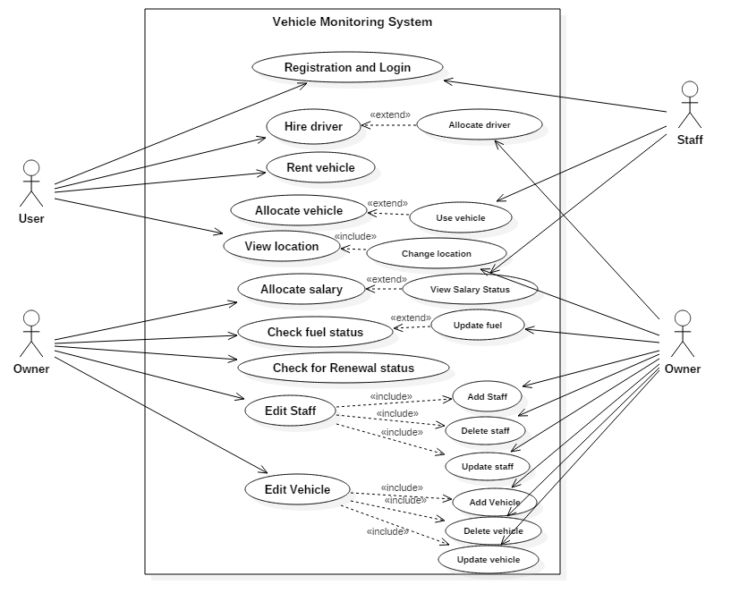
Design -3
Use Case

Slide 18
Design -4
Use Case diagram Justification
Helps in detailing user interaction goals with a product.
Relevant outlining and ensuring the requirements of a system.
Determining the specific needs of a project.
Modeling the basic flow of events in a use case.

Slide 19
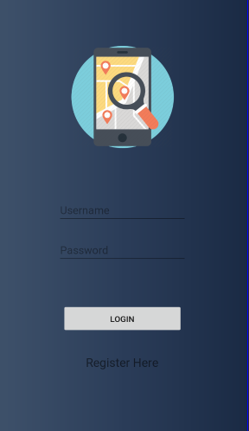
UI design

Slide 20
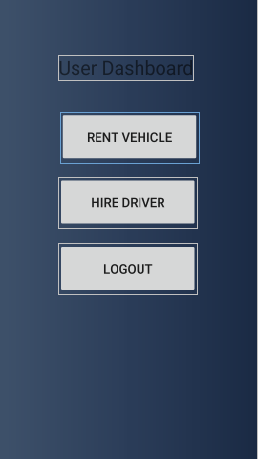
UI design -2

Slide 21
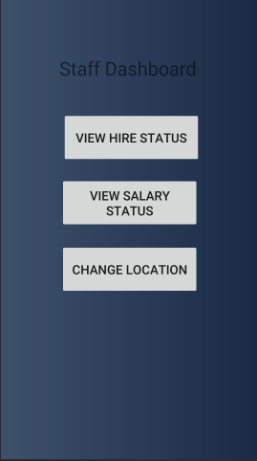
UI design -3

Slide 22
Future work
Developing a website for desktop users.
Automatic fuel tracking without manual insertion.

Slide 23
Limitations
Internet connectivity is a must for this project and on some hazards, correct information might not be provided to owners.
Manual insertion of fuel status is there.

Slide 24
Conclusion
Our application would somewhat assure security of our vehicle and handover to only trusted individuals. Also, necessary information about payments, reconditioning, servicing and deadlines are notified to owners along with suspicious activities. Data management is made easier and database handles it efficiently.

Slide 25
References
Scope of Project: https://totally.tech/how-to-define-the-scope-of-a-project/
Waterfall model: https://www.tutorialspoint.com/sdlc/sdlc_waterfall_model.htm
Design pattern: https://www.geeksforgeeks.org/mvc-design-pattern/
Scheduling: https://www.projectmanager.com/blog/what-is-project-scheduling
Risk Management: https://pm4id.org/chapter/11-2-risk-management-process/

